Slide 1
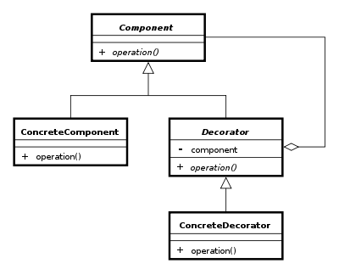
The Decorator pattern
Group 4
Asger Breinholm, Mathias Brændgaard and Rob Bertojo

Slide 2


The problem
Subclass everything
Extention at runtime

Slide 3
The solution – with Decorator

Slide 4
Pros & cons
Pros:
Less subclasses
Less memory usage
Cons:
More complex undo
More unnecessary code

Slide 5
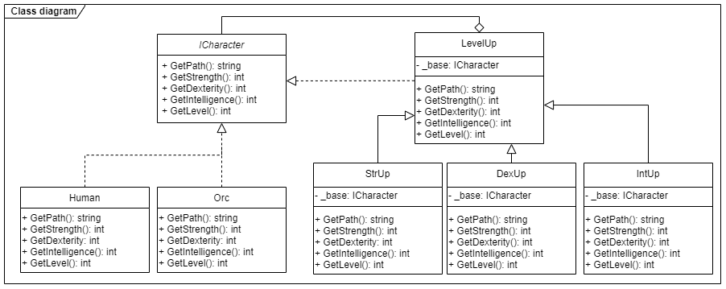
Class diagram

Slide 6
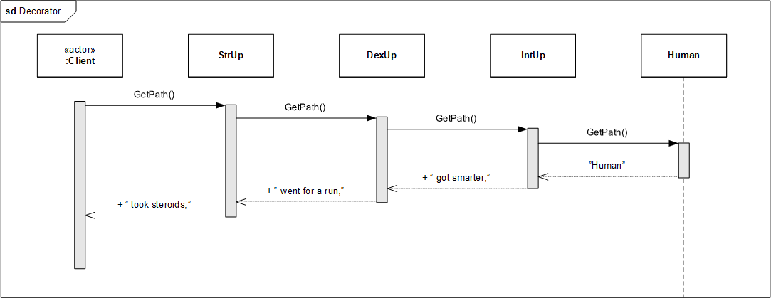
Sequence diagram

Slide 7
Our implementation
The base:
The decorator who inherits:

Slide 8
Comparison

Slide 9
Conclusion

